Slide 1


Slide 2




Adapter Design Pattern
Adapter pattern works as a bridge between two incompatible interfaces.
This type of design pattern comes under structural pattern as this pattern combines the capability of two independent interfaces.
This pattern involves a single class which is responsible to join functionalities of independent or incompatible interfaces.

Slide 3

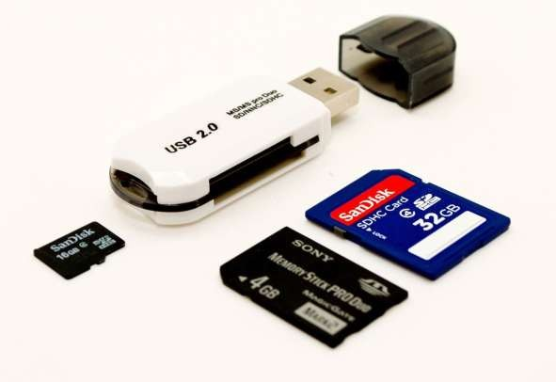
Example 1
 A real life example could be a case of card reader which acts as an adapter between memory card and a laptop.
You plugin the memory card into card reader and card reader into the laptop so that memory card can be read via laptop.

Slide 4

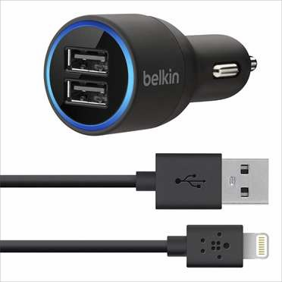
Example 2
 A real life example could be a Car mobile charger which acts as an adapter between cell phone USB cable and a car cigarette lighter power supply. You plugin the USB cable into car charger interface and car charger into the cigarette lighter power supply so that your cell phone can get the appropriate voltage required for charging.

Slide 5
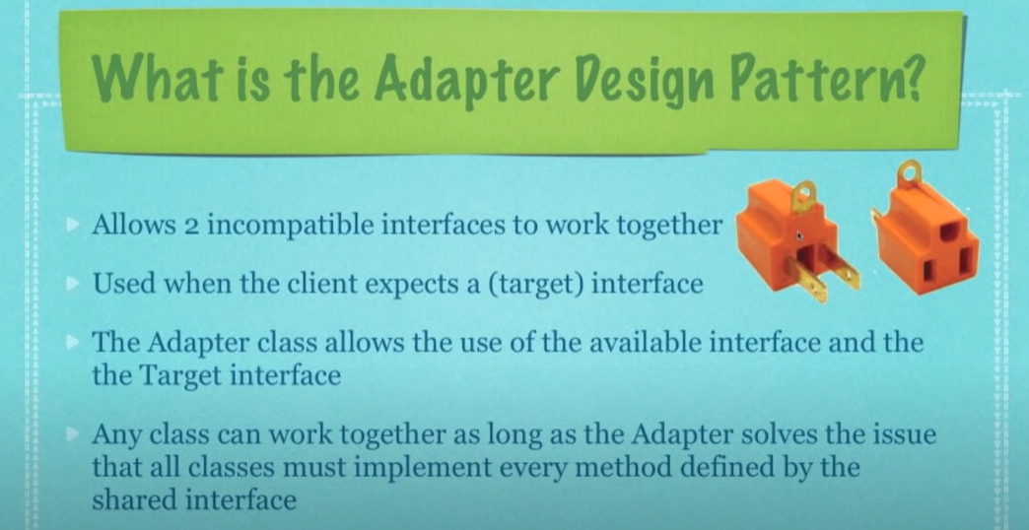

Slide 6
Adapter design pattern
The target interface defines the domain-specific interface used by the Client. The Client class uses the target interface. The Adaptee class defines an existing interface where adaption will be applied. This is the class which is used by the Adapter class to reuse the existing functionality and modify them for desired use. The Adapter class adapts interface Adaptee to the Target. This class is a wrapper class which implements the desired target interface and modifies the specific request available from the Adaptee class.

Slide 7
Difference between Façade and Adapter
Facade defines a new interface, whereas Adapter reuses an old interface. Remember that Adapter makes two existing interfaces work together as opposed to defining an entirely new one.

Slide 8
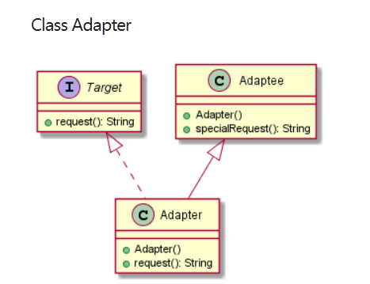
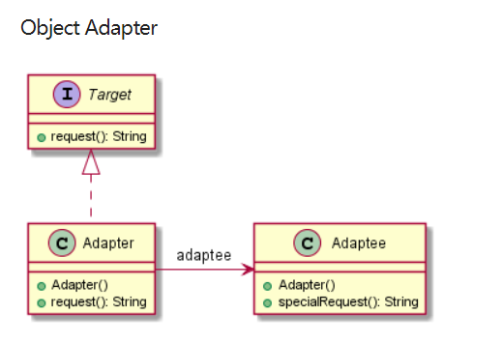
Implementation

Slide 9
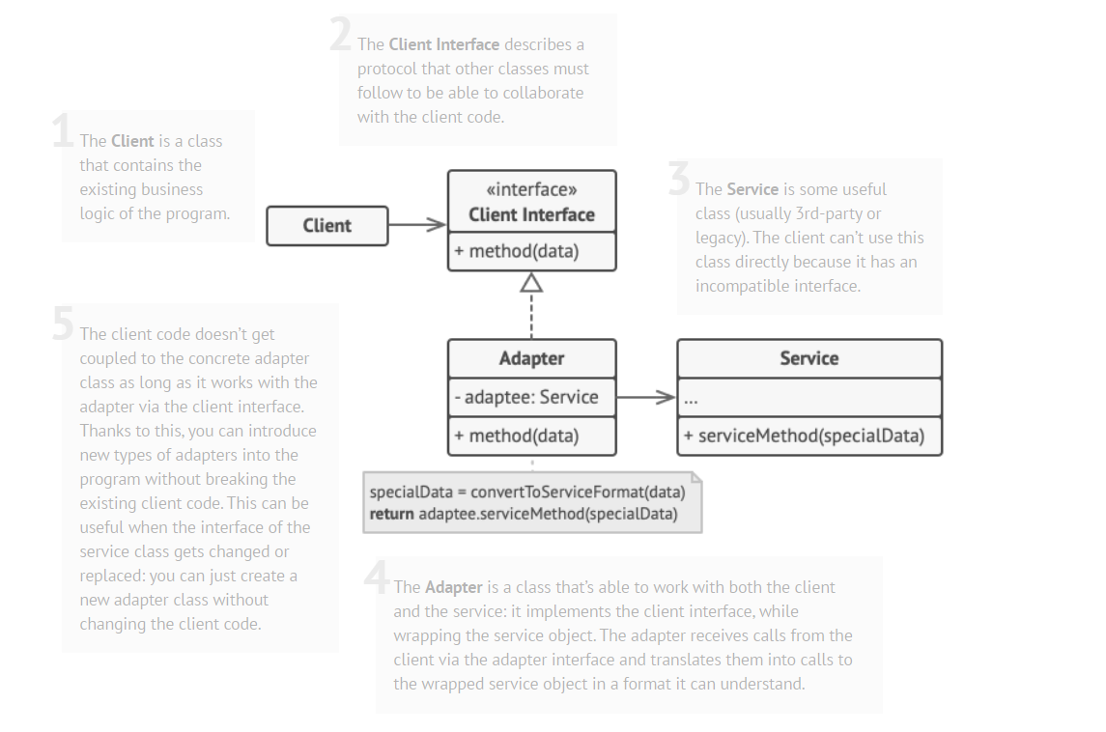

Slide 10
Class Adapter
Target.java
//Target interface, defines domain-specific interface to which Adaptee will be adapted
Expected interface by client
public interface Target {
String request();
}
Adaptee.java
//Adaptee class, interface which will be adapted. old interface
public class Adaptee {
public String specialRequest(){
return "specialRequest"; }
}

Slide 11
Class Adapter
Adapter.java
//Adapter class, adapts Adaptee to the Target interface
public class Adapter extends Adaptee implements Target {
public String request() {
return this.specialRequest(); }
}

Slide 12
Object Adapter
Target.java
public interface Target {
String request();
}
Adaptee.java
public class Adaptee {
public String specialRequest(){
return "specialRequest"; }
}

Slide 13
Object Adapter
Adapter.java
public class Adapter implements Target{ private Adaptee adaptee;
public Adapter(Adaptee adaptee) { this.adaptee = adaptee; }
public String request() {
return adaptee.specialRequest(); }
}

Slide 14

Example 3
 We are demonstrating use of Adapter pattern via following example in which an audio player device can play mp3 files only and wants to use an advanced audio player capable of playing vlc and mp4 files.

Slide 15

Implementation
We have a MediaPlayer interface and a concrete class AudioPlayer implementing
the MediaPlayer interface. AudioPlayer can play mp3 format audio files by default.
We are having another
interface AdvancedMediaPlayer and concrete classes implementing the AdvancedMediaPlayer interface.
These classes can play vlc and mp4 format files.

Slide 16

Implementation
We want to make AudioPlayer to play other formats as well. To attain this, we have created an adapter
class MediaAdapter which implements the MediaPlayer interface and
uses AdvancedMediaPlayer objects to play the required format.
AudioPlayer uses the adapter
class MediaAdapter passing it the desired audio type without knowing the actual class which can play the desired format. AdapterPatternDemo, our demo class will use AudioPlayer class to play various formats.

Slide 17

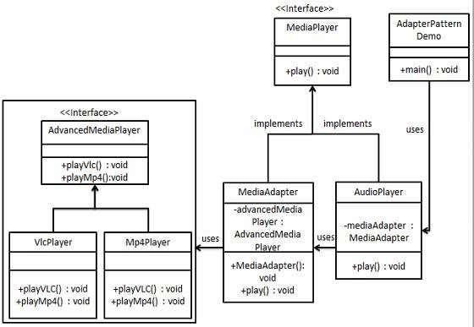
MediaAdapter

Slide 18
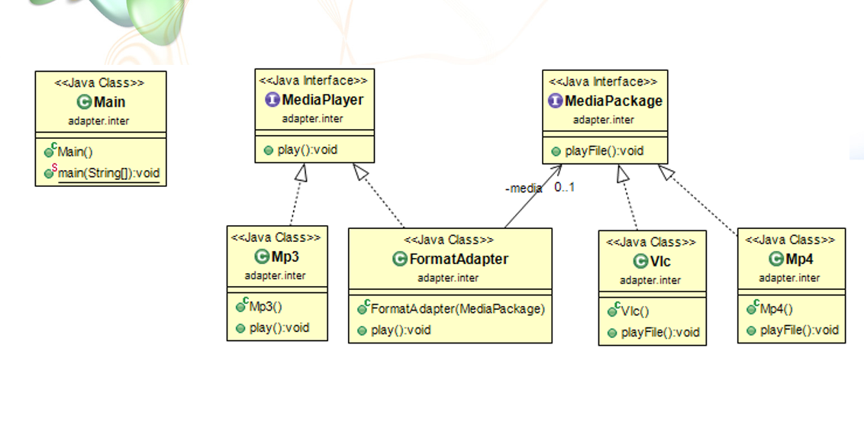

Slide 19

Step 1
Create interfaces for Media Player and Advanced Media Player.
MediaPlayer.java
public interface MediaPlayer {
public void play(String audioType, String fileName);
}
 AdvancedMediaPlayer.java
public interface AdvancedMediaPlayer { public void playVlc(String fileName); public void playMp4(String fileName);
}

Slide 20

Step 2
Create concrete classes implementing the AdvancedMediaPlayer interface.
VlcPlayer.java
public class VlcPlayer implements AdvancedMediaPlayer{
@Override
public void playVlc(String fileName) { System.out.println("Playing vlc file. Name: "+ fileName);
}
@Override
public void playMp4(String fileName) {
//do nothing
}
}

Slide 21

Step 2
Create concrete classes implementing the AdvancedMediaPlayer interface.
Mp4Player.java
public class Mp4Player implements AdvancedMediaPlayer{
@Override
public void playVlc(String fileName) {
//do nothing
}
@Override
public void playMp4(String fileName) { System.out.println("Playing mp4 file. Name: "+ fileName);
}
}

Slide 22

Step 3
 Create adapter class implementing
the MediaPlayer interface. (MediaAdapter.java)
public class MediaAdapter implements MediaPlayer { AdvancedMediaPlayer advancedMusicPlayer;
public MediaAdapter(String audioType){
if(audioType.equalsIgnoreCase("vlc") ){ advancedMusicPlayer = new VlcPlayer();
} else if (audioType.equalsIgnoreCase("mp4")){
advancedMusicPlayer = new Mp4Player();
} }
@Override
public void play(String audioType, String fileName) { if(audioType.equalsIgnoreCase("vlc")){
advancedMusicPlayer.playVlc(fileName);
} else if(audioType.equalsIgnoreCase("mp4")){ advancedMusicPlayer.playMp4(fileName);
}
}
}

Slide 23

Step 4
Create concrete class implementing the MediaPlayer interface.
AudioPlayer.java
public class AudioPlayer implements MediaPlayer { MediaAdapter mediaAdapter;
@Override
public void play(String audioType, String fileName) {
//inbuilt support to play mp3 music files if(audioType.equalsIgnoreCase("mp3")){
System.out.println("Playing mp3 file. Name: " + fileName);
}
//mediaAdapter is providing support to play other file formats else if(audioType.equalsIgnoreCase("vlc") ||
audioType.equalsIgnoreCase("mp4")){ mediaAdapter = new MediaAdapter(audioType); mediaAdapter.play(audioType, fileName);
} else{
System.out.println("Invalid media. " + audioType + " format not supported");
}
}}

Slide 24

Step 5
Use the AudioPlayer to play different types of audio formats.
AdapterPatternDemo.java
public class AdapterPatternDemo {
public static void main(String[] args) { AudioPlayer audioPlayer = new AudioPlayer();
audioPlayer.play("mp3", "beyond the horizon.mp3"); audioPlayer.play("mp4", "alone.mp4"); audioPlayer.play("vlc", "far far away.vlc"); audioPlayer.play("avi", "mind me.avi");
}
}

Slide 25

Step 6
 Verify the output.
Playing mp3 file. Name: beyond the horizon.mp3
Playing mp4 file. Name: alone.mp4 Playing vlc file. Name: far far away.vlc Invalid media. avi format not supported

Slide 27

Factory Pattern
 Factory pattern is one of the most used design patterns in Java. This type of design pattern comes under creational pattern as this pattern provides one of the best ways to create an object.
 In Factory pattern, we create object without exposing the creation logic to the client and refer to newly created object using a common interface.

Slide 28
Intent
Define an interface for creating an object, but let subclasses decide which class to instantiate.
Factory Method lets a class defer instantiation to subclasses.

Slide 29
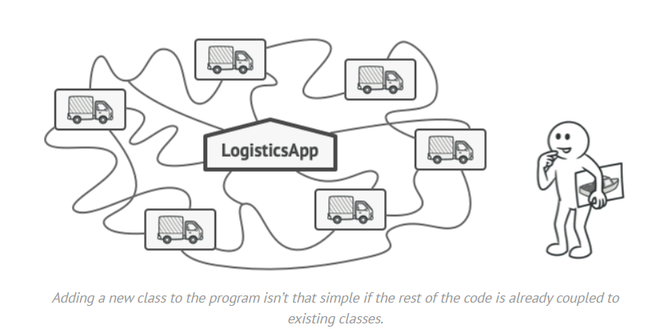
Problem

Slide 30

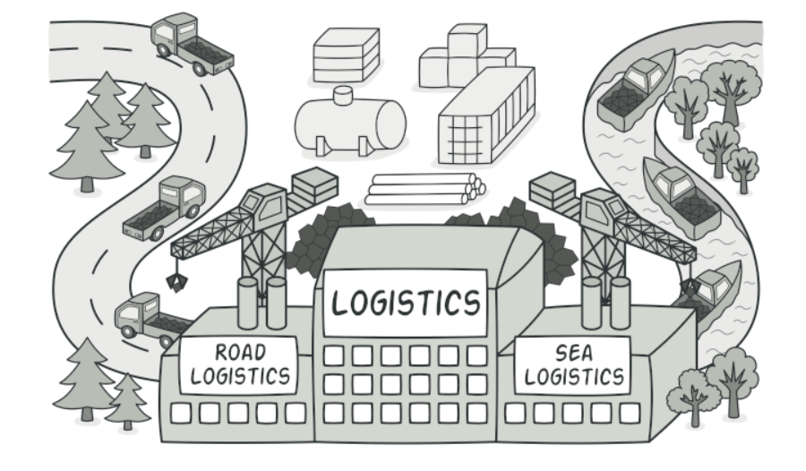
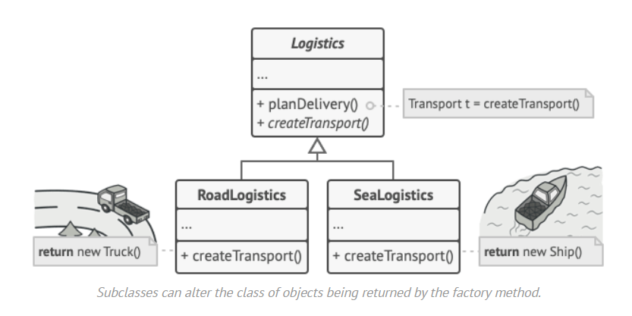
Solution

Slide 31
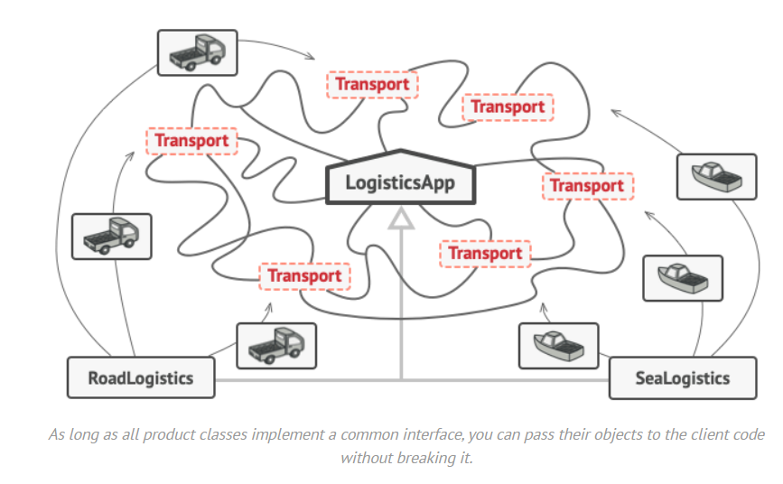
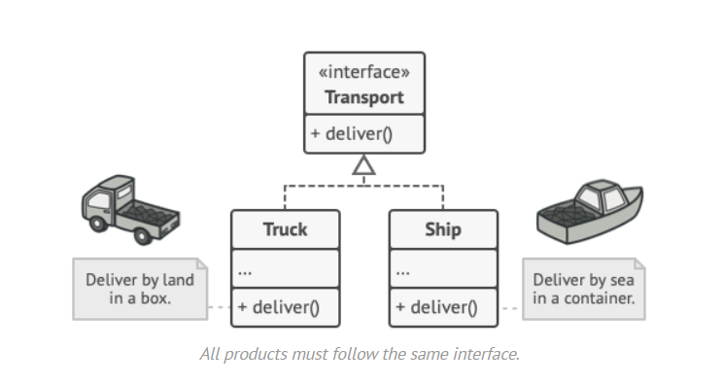
Solution

Slide 32
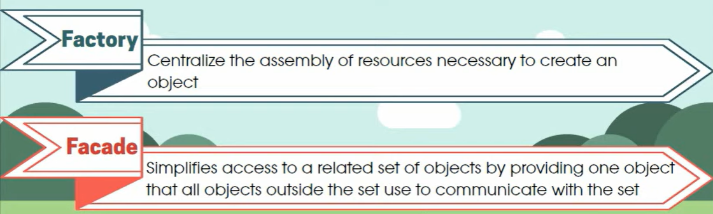

Slide 33
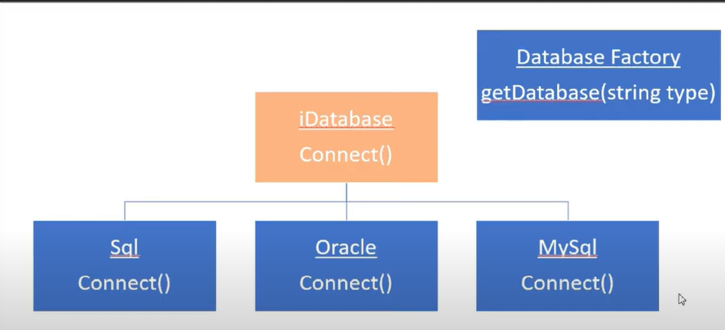

Slide 34
IDatabase.java
public interface IDatabase {
public void connect();
}
sql.java
public class sql implements IDatabase {
@Override
public void connect() {
System.out.println("hello from sql");
}
}

Slide 35
oracle.java
public class oracle implements IDatabase {
@Override
public void connect() {
System.out.println("hello from oracle");
}
}
mysql.java
public class mysql implements IDatabase {
@Override
public void connect() {
System.out.println("hello from mysql");
}
}

Slide 36
DatabaseFactory.java
public class DatabaseFactory {
public IDatabase getobj(String type) {
switch (type) {
case "sql":
return new sql();
case "mysql":
return new mysql();
case "oracle":
return new oracle();
default:
return null;
}}}

Slide 37
client.java
public class client {
public static void main(String[] args) {
DatabaseFactory db = new DatabaseFactory();
IDatabase database = db.getobj("sql");
database.connect();
}
}

Slide 38

Implementation
 We're going to create a Shape interface and concrete classes implementing the Shape interface. A factory class ShapeFactory is defined as a next step.
 FactoryPatternDemo, our demo class will
use ShapeFactory to get a Shape object. It will pass information (CIRCLE / RECTANGLE / SQUARE) to ShapeFactory to get the type of object it needs.

Slide 39

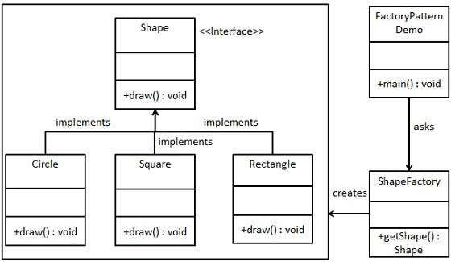
Implementation

Slide 40

Step 1
 Create an interface. (Shape.java)
public interface Shape {
void draw();
}

Slide 41

Step 2
 Create concrete classes implementing the same interface.
public class Rectangle implements Shape { @Override
public void draw() {
System.out.println("Inside Rectangle::draw() method.");
} }
public class Square implements Shape { @Override
public void draw() {
System.out.println("Inside Square::draw() method.");
} }
public class Circle implements Shape { @Override
public void draw() {
System.out.println("Inside Circle::draw() method.");
} }

Slide 42

Step 3
 Create a Factory to generate object of concrete class based on given information. (ShapeFactory.java)
public class ShapeFactory {
//use getShape method to get object of type shape
public Shape getShape(String shapeType){ if(shapeType == null){
return null;
}
if(shapeType.equalsIgnoreCase("CIRCLE")){
return new Circle();
} else if(shapeType.equalsIgnoreCase("RECTANGLE")){ return new Rectangle();
} else if(shapeType.equalsIgnoreCase("SQUARE")){
return new Square();
}
return null;
} }

Slide 43

Step 4
 Use Factory to get object of concrete class by passing information such as type. (FactoryPatternDemo.java)
public class FactoryPatternDemo {
public static void main(String[] args) { ShapeFactory shapeFactory = new ShapeFactory(); Shape shape1 = shapeFactory.getShape("CIRCLE"); shape1.draw();
Shape shape2 = shapeFactory.getShape("RECTANGLE"); shape2.draw();
Shape shape3 = shapeFactory.getShape("SQUARE"); shape3.draw();
}
}

Slide 44

Step 5
 Verify the output.
Inside Circle::draw() method. Inside Rectangle::draw() method. Inside Square::draw() method.

